Slide 1








Slide 2
About team

Slide 3
Web Scraping

Slide 4
What is web scraping?
Web scraping is also called Web harvesting or Webb data extraction or even Web data mining
Can be defined as The construction of an agent to download and organize data from the Web in an automated manner
In other words instead of human and user clicking away in a Web browser and copy pasting interesting parts into a spreadsheet Web scraping offloads this task to computer program that can execute much faster and more correctly then a human can

Slide 5
Why web scraping?
There might be an interesting table or information on pages that you want you to retrieve to perform statistical analysis
You want to get a list of reviews from website to perform text mining create recommendation our build predictive model
Might wish to get a listing of properties on a real estate site to build an appealing Geo visualizetion
Web scraping always makes it easy to gather or export data in an easy manner

Slide 6

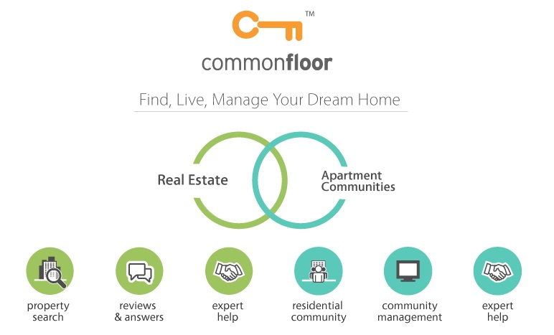
Web Scraping
Rent a House
www.commonfloor.com

Slide 7
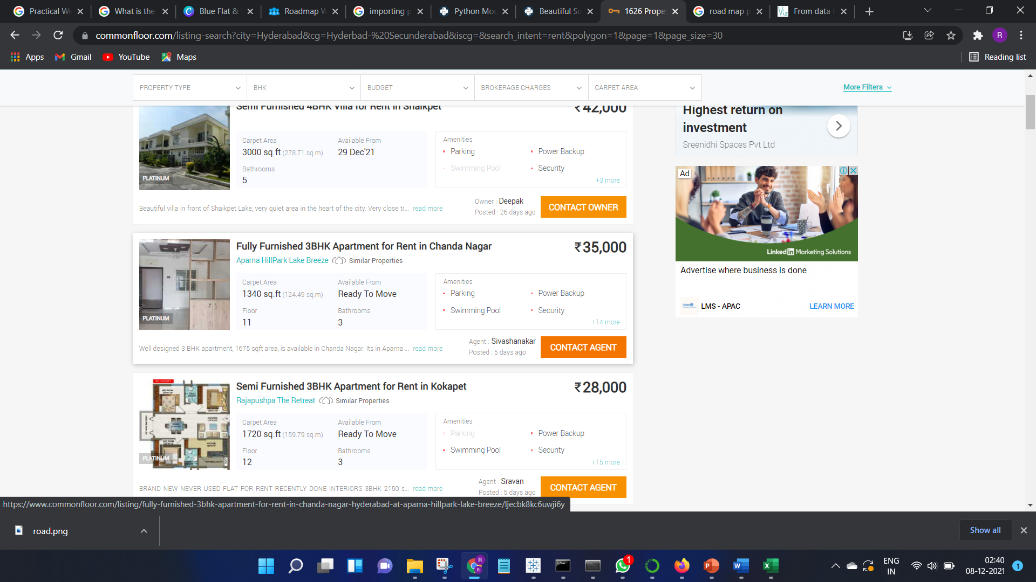
Introduction of the website

Slide 8

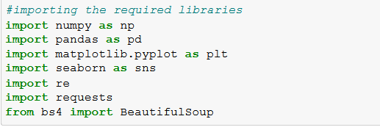
Requirements
Language:
Python
Libraries:
Numpy
Pandas
Matplotlib
Seaborm
Regression
Requests
Bs 4/ Beautiful Soup
Step1:importing the libraries

Slide 9
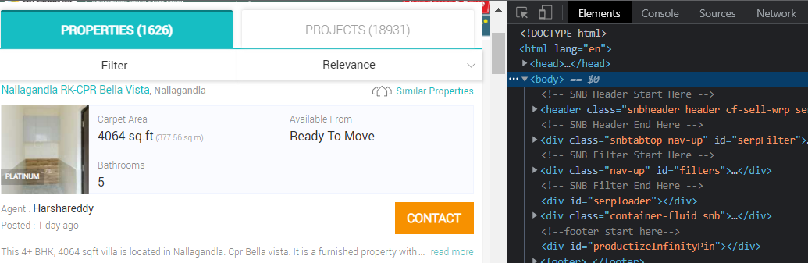
Step1:Getting started with web page
Identifying the URL:
Inspect the HTML code

Slide 10
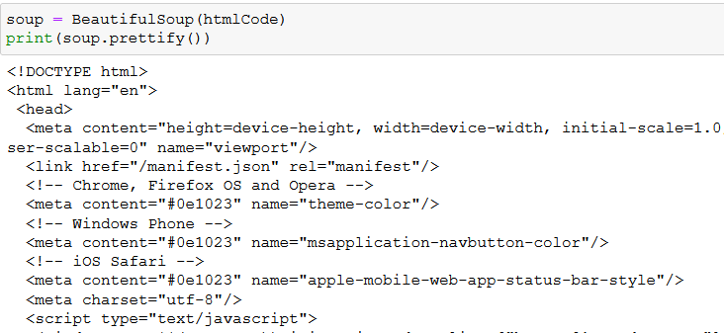
Parse HTML Code With Beautiful Soup
Inspect the HTML code & Find Elements by ID

Slide 11
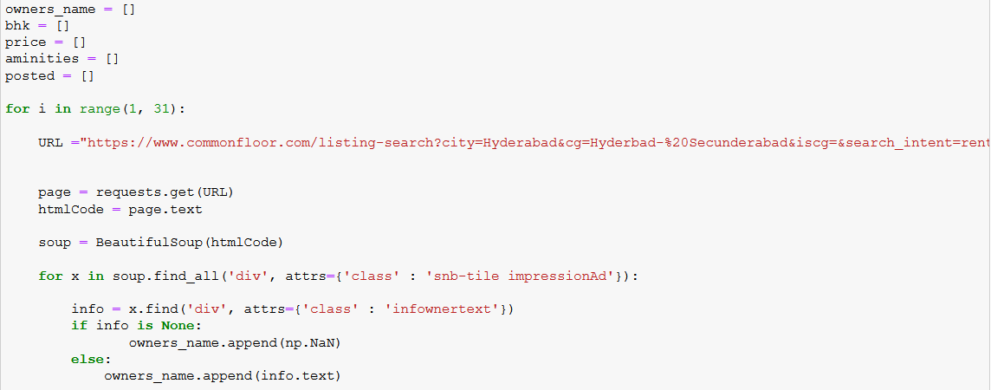
Step2:Fetching the data from the website

Slide 12
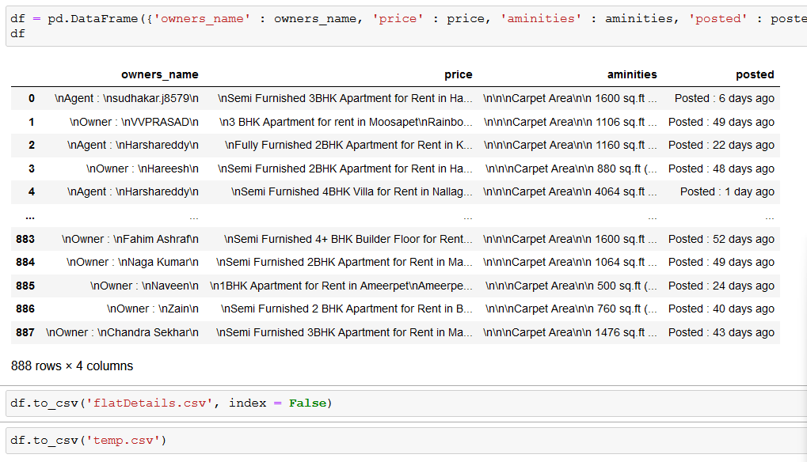
Step3: Converting Raw data into csv file
Creating Data Frame and converting into csv file and storing the file

Slide 13
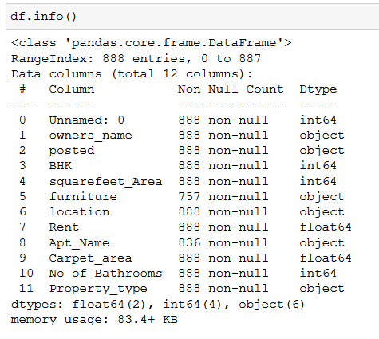

Step4:Data manipulation
Looking at the type of data we have
And converting the data into user helpful types

Slide 14
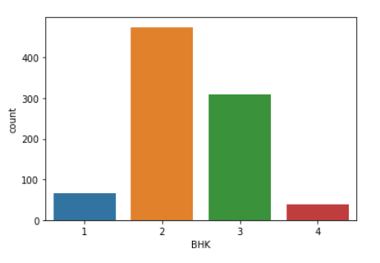
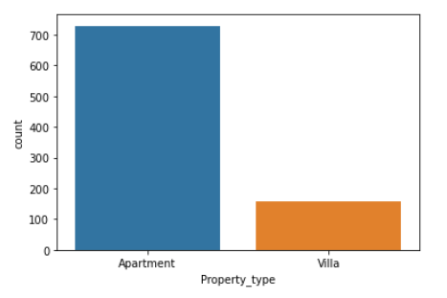
Step5:Data Visualization(Univariate)
Univariate analysis:
Number or count of houses based its type(1BHK, 2BHK, 3BHK)
Number or count of houses based its property type
.
.
Notes:
1 count plot(BHK): 2BHK are more in number. 2 countplot(Property type): apparments are more in number

Slide 15
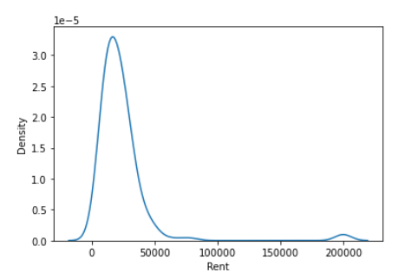
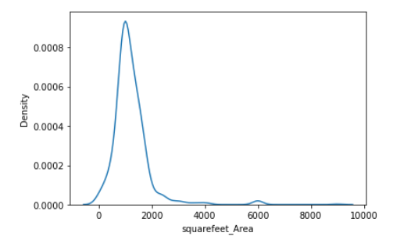
Density distribution over square feet area
Density distribution over Rent
Notes:
1. Density is more between 1.5K | 2.rent density is more on 25K

Slide 16
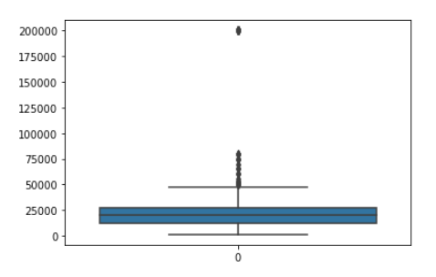
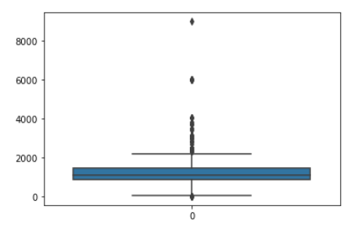
Box plot for Rent
Box plot for Squarefeet_Area
Notes:
1. Out liars In rent | out liars in sqt area

Slide 17
Distribution
.
Notes:
We got more post before 51 days

Slide 18
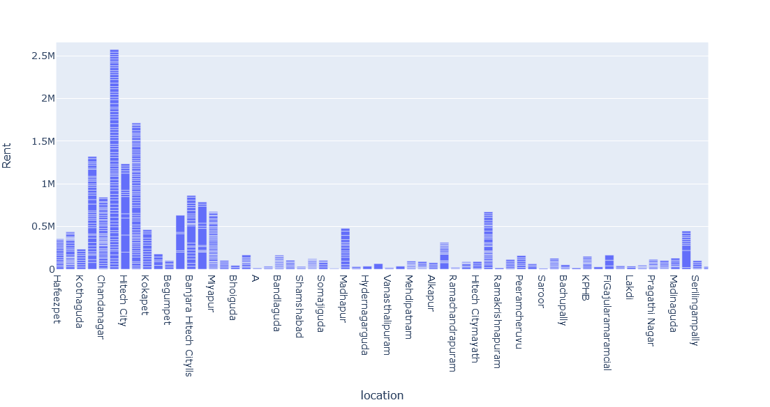
Bar plot based on location
Notes:
Chanda nagar and high-tech city have higher rent

Slide 19
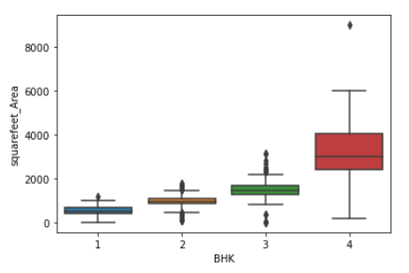
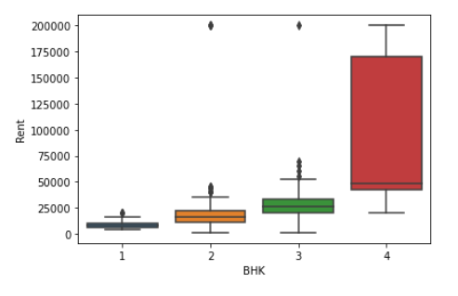
Data Visualization(Bivariate)
Box plot for squarefeet_Area
Box plot for Rent
Notes:
Sns box plot

Slide 20
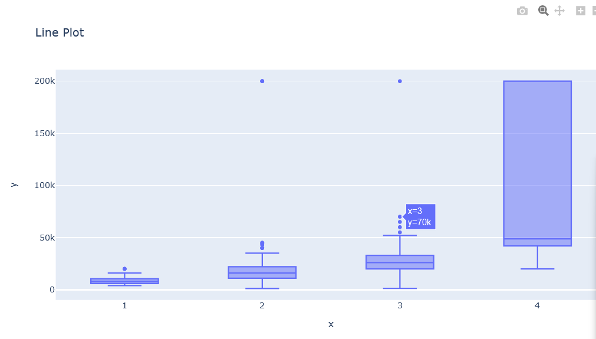
Combined box plot of no BHK and rent
Notes:
Putting BHK in same box plot vs rent

Slide 21
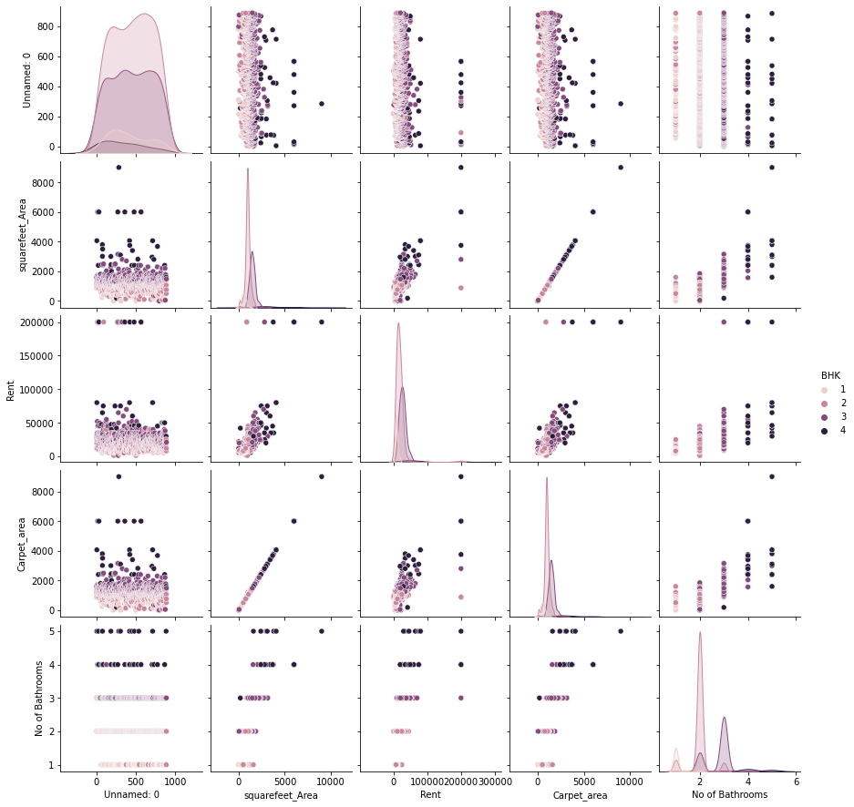
Pairplot

Slide 22
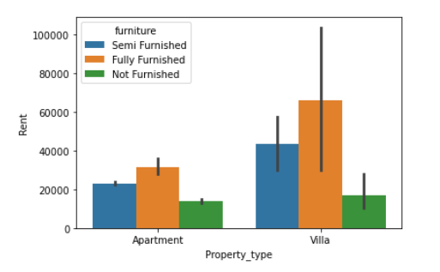
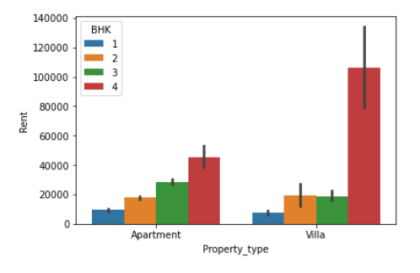
Property type v/s Rent with furniture as value
Property type v/s Rent with BHK as value
Notes:
Sns barplot,

Slide 23
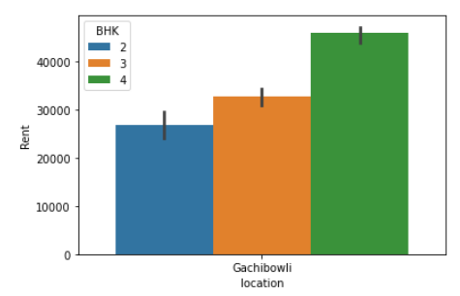
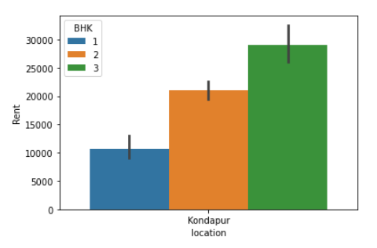
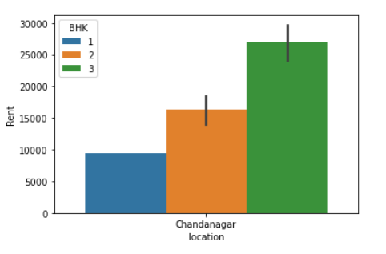
Analysis based on locations where more properties are listed for rent
Gachibowli
Kondapur
Chandanagar

Slide 24
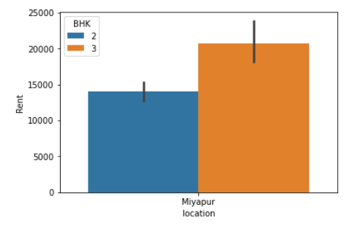
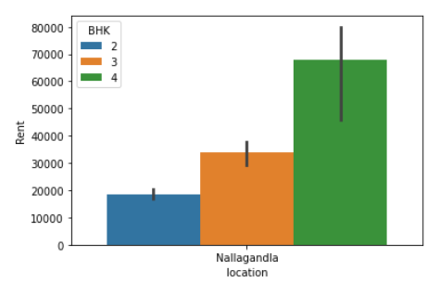
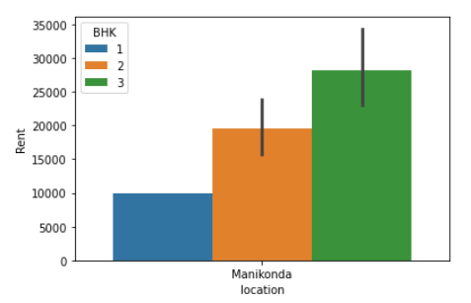
Analysis based on locations where more properties are listed for rent
Miyapur
Nallagandla
Manikonda

Slide 25
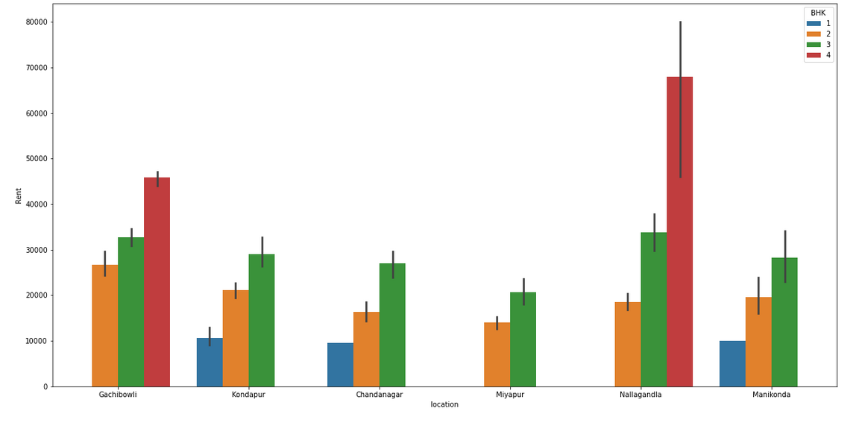
Comparison of rent and number of rooms(BHK) for top 6 locations
Notes:
fig=plt.subplots(figsize=(20,10))
sns.barplot(x=df['location'],order=df['location'].value_counts().iloc[:6].index, y='Rent', hue='BHK', data=df)

Slide 26
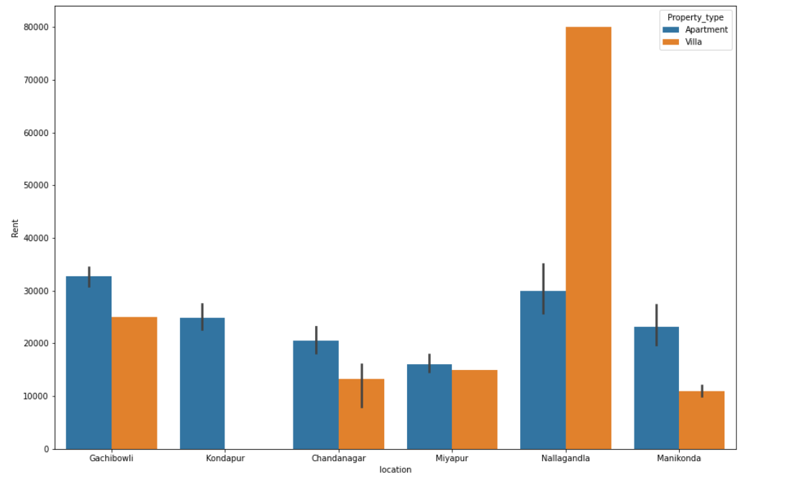
Comparison of rent and property type for top 6 locations
Notes:
fig=plt.subplots(figsize=(15,10))
sns.barplot(x=df['location'],order=df['location'].value_counts().iloc[:6].index, y='Rent', hue='Property_type', data=df)

Slide 27
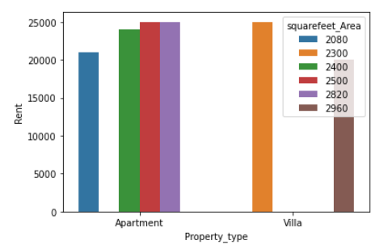
House distribution with square-feet Area equal to 2000 or more?
Notes:
df_B1=df[(df['squarefeet_Area']>=2000)&(df['Rent']<=25000)] sns.barplot(x='Property_type', y='Rent', hue='squarefeet_Area', data=df_B1)

Slide 28
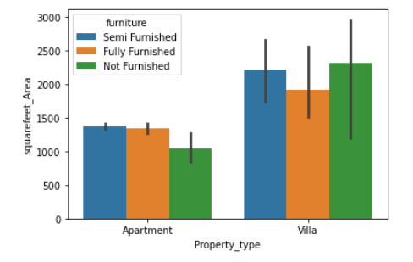

If rent capability is from 20k to 50K?
Notes:
df_B11=df[(df['Rent']>=20000)&(df['Rent']<=50000)] sns.barplot(x='Property_type', y='squarefeet_Area', hue='furniture', data=df_B11)

Slide 29

THANK YOU

